Slide 1
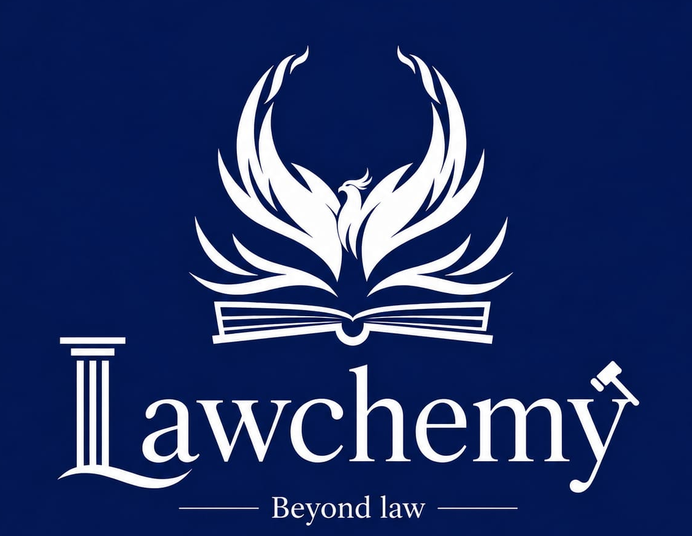
A 5-WEEK CERTIFICATE COURSE
AI Research Tools
Master ChatGPT, Gemini, Claude and 15+ AI platforms to search, review,
analyse, write and verify academic research — the smart way.
10 Live Classes · 5 Weeks · Hands-on Every Session

Slide 2

WELCOME
Welcome to Lawchemy
Why This Course Exists
Academic and legal research is changing fast — AI tools now assist with everything from literature search to data analysis.
BEYOND LAW
Most students and researchers use AI casually, without structure — often producing unreliable or unverifiable work.
Lawchemy exists to take learners beyond the traditional boundaries of law — into the modern, technology-driven skills every researcher and professional now needs.
This course builds a disciplined, tool-by-tool, step-by-step workflow so that AI becomes a research partner, not a shortcut.
By the end, you'll be equipped to research faster, write better and stay ethically sound — all at once.
This course blends legal-research rigour with cutting-edge Artificial Intelligence — so you don't just use AI, you use it responsibly and effectively.
LAWCHEMY | AI RESEARCH TOOLS — 5-WEEK COURSE
02

Slide 3




COURSE SNAPSHOT
Course at a Glance
5 Weeks
10 Classes
10 Assignments
Final Project
Total course duration
2 live classes every week
A hands-on task after every class
Mini research proposal presentation
Course Format
Two live classes every week, building progressively from foundations to an advanced personal workflow
Every class pairs a concept with a specific practical activity or assignment using real AI tools
The course closes with a final mini research proposal built entirely using AI research tools
LAWCHEMY | AI RESEARCH TOOLS — 5-WEEK COURSE
03

Slide 4






WHY THIS MATTERS
Why Learn AI Research Tools?
AI is already part of how research gets done. The only question is whether you use it with skill, or without it.
Research Faster
Avoid Hallucinations
Analyse with Confidence
Cut down literature search and review time from weeks to days
Learn to detect fake citations & verify every AI-generated fact
Turn raw data into clear findings using AI-assisted analysis
Write with Clarity
Stay Ethical
Build One Workflow
Draft, edit and polish academic writing with AI support
Understand academic integrity & responsible AI disclosure
Combine every tool into a single, personal research system
LAWCHEMY | AI RESEARCH TOOLS — 5-WEEK COURSE
04

Slide 5
THE FULL JOURNEY
Your 5-Week Course Roadmap
1
Week 1
Introduction to AI in Academic Research · Prompt Engineering for Research
Foundations
2
Week 2
AI Tools for Literature Search & Discovery · AI-Assisted Literature Review & Research Gap Identification
Literature
3
Week 3
AI for Research Methodology & Research Design · AI-Assisted Data Analysis & Interpretation
Methodology
4
Week 4
AI-Assisted Academic Writing · AI for Citation, Referencing & Academic Integrity
Writing & Integrity
5
Week 5
Advanced AI Research Workflow & Fact Verification · Final Research Project & Responsible AI Use
Mastery
LAWCHEMY | AI RESEARCH TOOLS — 5-WEEK COURSE
05

Slide 6


WEEK 1 · FOUNDATIONS
Introduction to AI in Academic Research & Prompt Engineering for Research
CLASS 1
CLASS 2
Introduction to AI in Academic Research
Prompt Engineering for Research
KEY CONTENTS
KEY CONTENTS
Meaning and evolution of AI; AI, Machine Learning and Generative AI; traditional vs. AI-assisted research; role of AI in the research lifecycle; opportunities and limitations.
Meaning and importance of prompts; components of effective prompts; zero-shot, few-shot and role-based prompting; AI for research topics, questions, objectives and hypotheses.
AI TOOLS / PLATFORMS
AI TOOLS / PLATFORMS
ChatGPT, Gemini, Claude, Microsoft Copilot, Perplexity
ChatGPT, Gemini, Claude
PRACTICAL ACTIVITY
PRACTICAL ACTIVITY
Compare responses generated by different AI tools on the same research question.
Develop a research workflow: Topic → Research Problem → Research Questions → Objectives → Keywords.
LAWCHEMY | AI RESEARCH TOOLS — 5-WEEK COURSE
06

Slide 7


WEEK 2 · LITERATURE
AI Tools for Literature Search & Research Discovery & AI-Assisted Literature Review & Research Gap Identification
CLASS 3
CLASS 4
AI Tools for Literature Search & Research Discovery
AI-Assisted Literature Review & Research Gap Identification
KEY CONTENTS
KEY CONTENTS
Searching academic literature; identifying relevant and recent research; locating seminal works; keyword generation; preliminary research gap identification.
Summarizing research papers; comparing studies; identifying themes, trends and contradictions; preparing literature reviews and identifying research gaps.
AI TOOLS / PLATFORMS
AI TOOLS / PLATFORMS
Google Scholar, Semantic Scholar, Consensus, Elicit, Perplexity
Elicit, Research Rabbit, Connected Papers, SciSpace, ChatGPT
PRACTICAL ACTIVITY
PRACTICAL ACTIVITY
Identify five relevant papers, three recent studies and two foundational works on a selected topic.
Prepare a Literature Review Matrix containing Author, Research Question, Methodology, Findings and Research Gap.
LAWCHEMY | AI RESEARCH TOOLS — 5-WEEK COURSE
07

Slide 8


WEEK 3 · METHODOLOGY
AI for Research Methodology & Research Design & AI-Assisted Data Analysis & Interpretation
CLASS 5
CLASS 6
AI for Research Methodology & Research Design
AI-Assisted Data Analysis & Interpretation
KEY CONTENTS
KEY CONTENTS
Doctrinal and empirical research; qualitative and quantitative research; research design; hypotheses; sampling; questionnaires and interview questions.
Introduction to qualitative and quantitative data analysis; data cleaning; classification; thematic analysis; coding responses; interpretation and presentation of findings.
AI TOOLS / PLATFORMS
AI TOOLS / PLATFORMS
ChatGPT, Gemini, Claude and AI-assisted research tools
ChatGPT, Microsoft Excel, Google Sheets and AI-assisted analytical tools
PRACTICAL ACTIVITY
PRACTICAL ACTIVITY
Develop a complete research methodology for a selected research topic.
Analyse a sample dataset and prepare key findings, themes and interpretations.
LAWCHEMY | AI RESEARCH TOOLS — 5-WEEK COURSE
08

Slide 9


WEEK 4 · WRITING & INTEGRITY
AI-Assisted Academic Writing & AI for Citation, Referencing & Academic Integrity
CLASS 7
CLASS 8
AI-Assisted Academic Writing
AI for Citation, Referencing & Academic Integrity
KEY CONTENTS
KEY CONTENTS
Developing research outlines; writing introductions; literature reviews; arguments and analysis; improving coherence; academic language; editing and proofreading.
Citation generation and verification; AI hallucinations; fake references; plagiarism; responsible use of AI; academic integrity.
AI TOOLS / PLATFORMS
AI TOOLS / PLATFORMS
ChatGPT, Gemini, Claude, Grammarly and other writing assistants
Zotero, Mendeley, SciSpace, Google Scholar and AI citation tools
PRACTICAL ACTIVITY
PRACTICAL ACTIVITY
Prepare a complete research paper outline from title to conclusion.
Verify AI-generated references and prepare a correctly formatted bibliography.
LAWCHEMY | AI RESEARCH TOOLS — 5-WEEK COURSE
09

Slide 10


WEEK 5 · MASTERY
Advanced AI Research Workflow & Fact Verification & Final Research Project & Responsible AI Use
CLASS 9
CLASS 10
Advanced AI Research Workflow & Fact Verification
Final Research Project & Responsible AI Use
KEY CONTENTS
KEY CONTENTS
Integrating multiple AI tools; cross-verification; detecting hallucinations; fact-checking; identifying reliable sources; bias and limitations of AI.
Ethical challenges; privacy; bias; copyright; intellectual property; disclosure of AI use; future of AI in research.
AI TOOLS / PLATFORMS
AI TOOLS / PLATFORMS
ChatGPT, Perplexity, Google Scholar, Elicit and verification tools
All tools covered during the course
PRACTICAL ACTIVITY
PRACTICAL ACTIVITY
Develop a personal AI-Assisted Research Workflow for an individual research project.
Prepare and present a Mini Research Proposal using AI Research Tools.
LAWCHEMY | AI RESEARCH TOOLS — 5-WEEK COURSE
10

Slide 11



YOUR TOOLKIT
AI Tools & Platforms You'll Master
Conversational AI
Literature Search & Discovery
ChatGPT, Gemini, Claude, Microsoft Copilot, Perplexity
Google Scholar, Semantic Scholar, Consensus, Elicit
Review & Synthesis
Data Analysis
Research Rabbit, Connected Papers, SciSpace
Microsoft Excel, Google Sheets
Writing Assistance
Citation & Reference Management
Grammarly and other AI writing assistants
Zotero, Mendeley
LAWCHEMY | AI RESEARCH TOOLS — 5-WEEK COURSE
11

Slide 12

WHAT YOU'LL WALK AWAY WITH
Skills & Learning Outcomes
Critically compare outputs from multiple AI tools instead of trusting just one
Analyse data and extract themes & findings with AI-assisted tools
Build a structured research workflow from topic to keywords using AI
Draft, edit and polish an academic paper from outline to conclusion
Search, discover and shortlist relevant academic literature efficiently
Verify citations, detect AI hallucinations and avoid fake references
Prepare a complete literature review matrix and identify real research gaps
Combine every tool into one personal, dependable research workflow
Design a full research methodology — qualitative, quantitative or doctrinal
Apply AI responsibly — with disclosure, ethics and academic integrity
LAWCHEMY | AI RESEARCH TOOLS — 5-WEEK COURSE
12

Slide 13




IS THIS FOR YOU?
Who Should Join This Course?
This course is designed for:
Undergraduate & postgraduate students working on projects, theses or dissertations
Research scholars & PhD candidates who want a faster, more reliable workflow
Certificate of Completion
Academicians and faculty guiding student research
Awarded by Lawchemy on successful completion of all 10 classes and the final mini research proposal.
Working professionals conducting research, reports or policy work
Anyone curious about using AI tools responsibly for serious academic work
“Beyond Law” means beyond boundaries — bring your curiosity, we'll bring the tools.
No advanced technical background required — just a computer, curiosity and a research topic in mind.
LAWCHEMY | AI RESEARCH TOOLS — 5-WEEK COURSE
13

Slide 14



Seats Are Limited — Enrol Today
Take the first step towards researching smarter, faster and more responsibly with AI.
Call / WhatsApp
Email
Visit
Reach out to the Lawchemy team
Write to us for a detailed brochure
Connect with us at our official channels
LAWCHEMY · BEYOND LAW
AI Research Tools — 5-Week Certificate Course

